Slide 1

FINAL PROJECT HOUSE PRICING
BY- ANUBHAV RASTOGI

Slide 2
ABOUT THE DATASET
In the present assignment, I have taken House Pricing dataset.
This dataset is one of the Kaggle Competition datasets.
The dataset contains information about house pricing and the variables affecting it.
The dataset is divided into 2 parts: train dataset and test dataset.
The combined dataset has 2919 rows in total and 81 column variables out of which 79 are explanatory variables describing every aspect of the residential home.

Slide 3
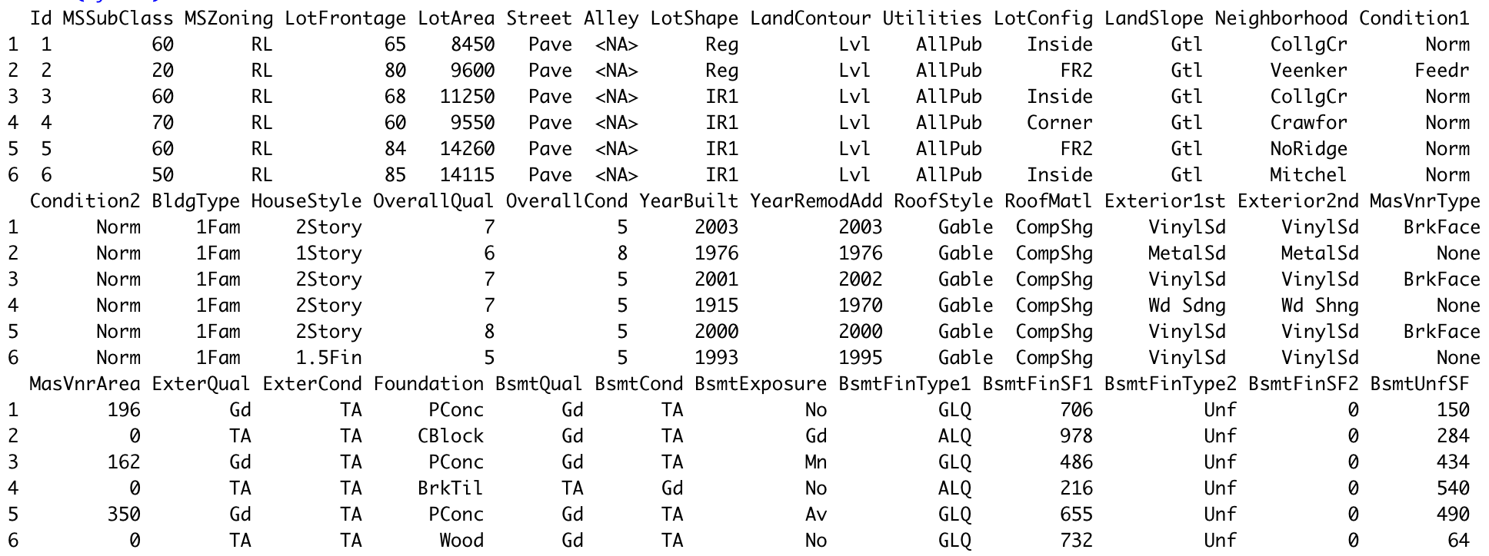
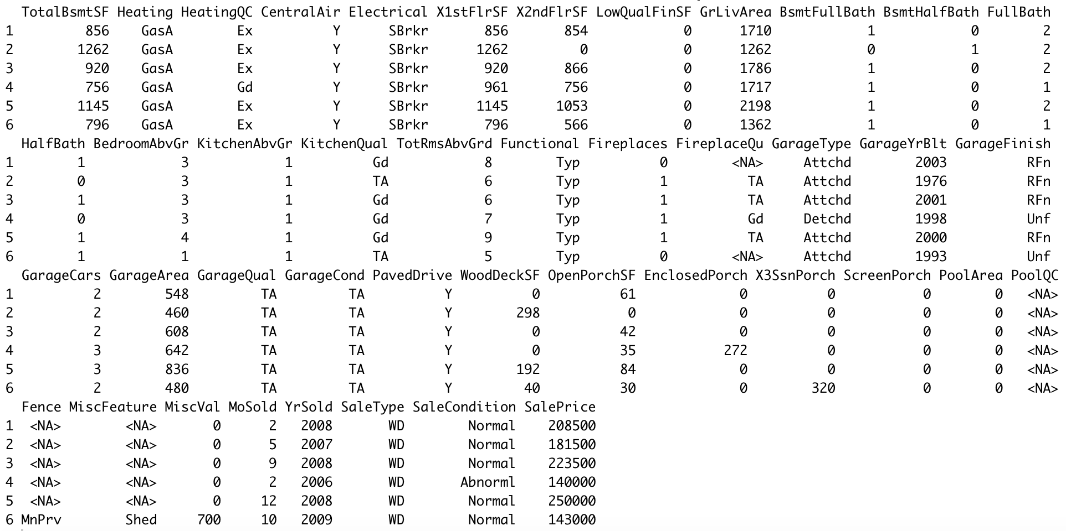
HEAD OF DATA SET

Slide 4
GOAL OR OBJECTIVE
In this assignment, we are trying to predict the house prices.
Here, SalePrice is the response variable here while other 79 column variables are predictors.
The goal or objective is to perform some data mining techniques and do the exploratory data analysis.
Predictive modeling techniques such as random forest and linear regression are to be performed to predict the Sale Price of the houses.

Slide 5
STEPS TAKEN
Importing Package
Looking at the data
Checking the dimension and row duplication
Combining the data
Creating numeric and categorical variables
Performing EDA
Finding the missing values
Handling Missing Values (Mean/Median)
Changing N/A values
Factorizing
Splitting test and train
Dealing with Skewness
Setting the seed
Variable Importance
Building the models

Slide 6
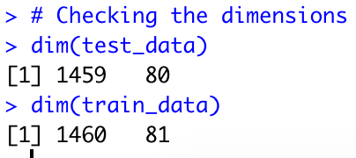
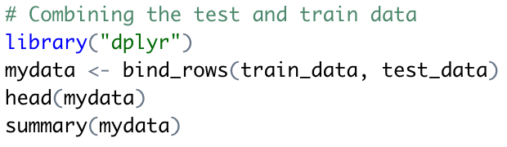
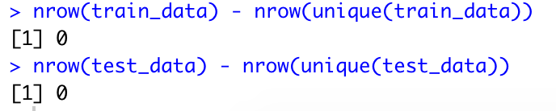
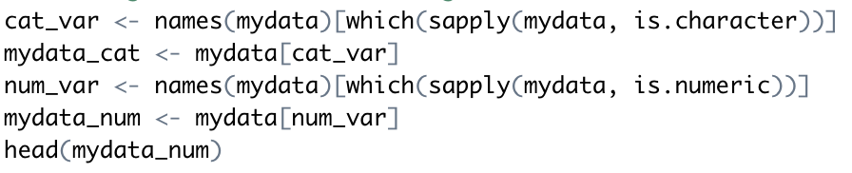
PERFORMING STEPS
The dataset was in 2 files: test data set and train dataset
The dimensions of the dataset are different.
Both the datasets have been combined through bind rows command instead or rbind function
There are no duplicate rows present in both the dataset
Creating dataset one with categorical and another with numeric variable

Slide 7
EXPLORATORY DATA ANALYSIS
In order to explore the data, we have used a library known as Data Explorer library.
It helps in easy EDA (Exploratory Data Analysis).
EDA refers to the process of summarizing and analyzing the data sets as per their characteristics and often involves visual methods.
It is a process of carefully observing the data and what the data tell us beyond modeling or hypothesis testing.

Slide 8

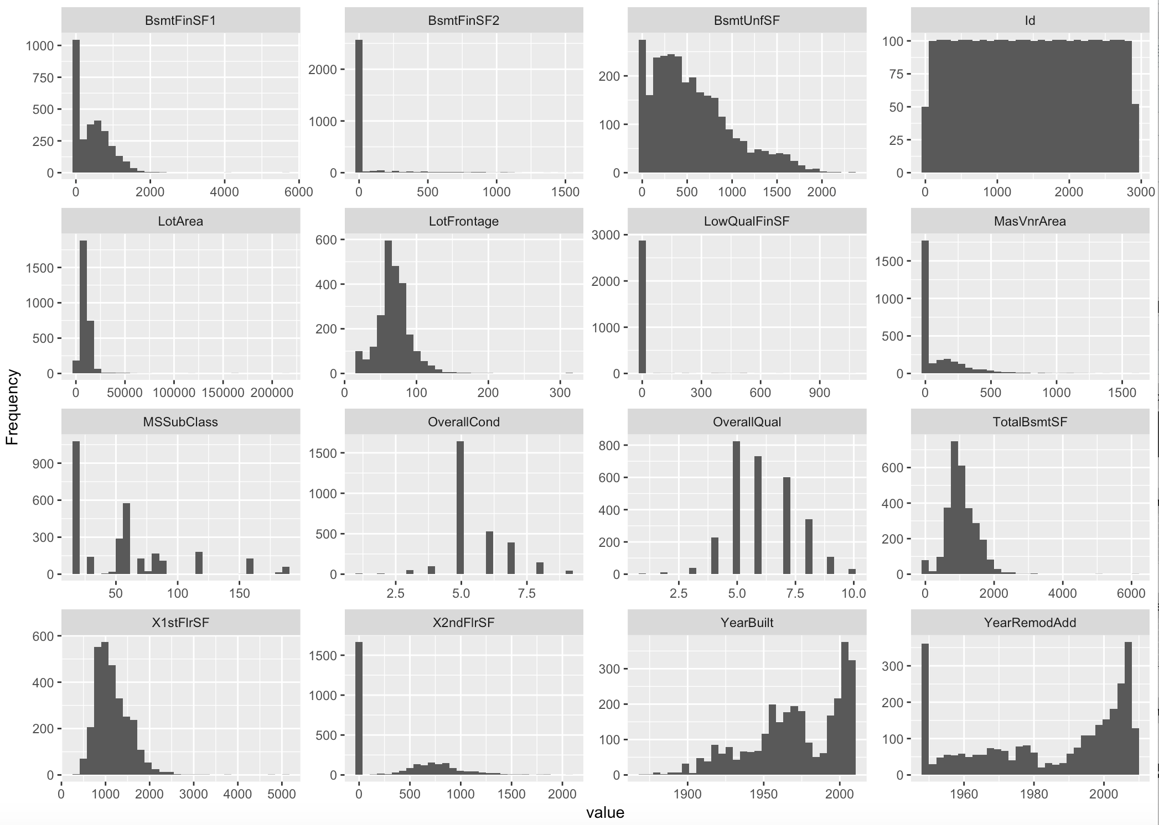
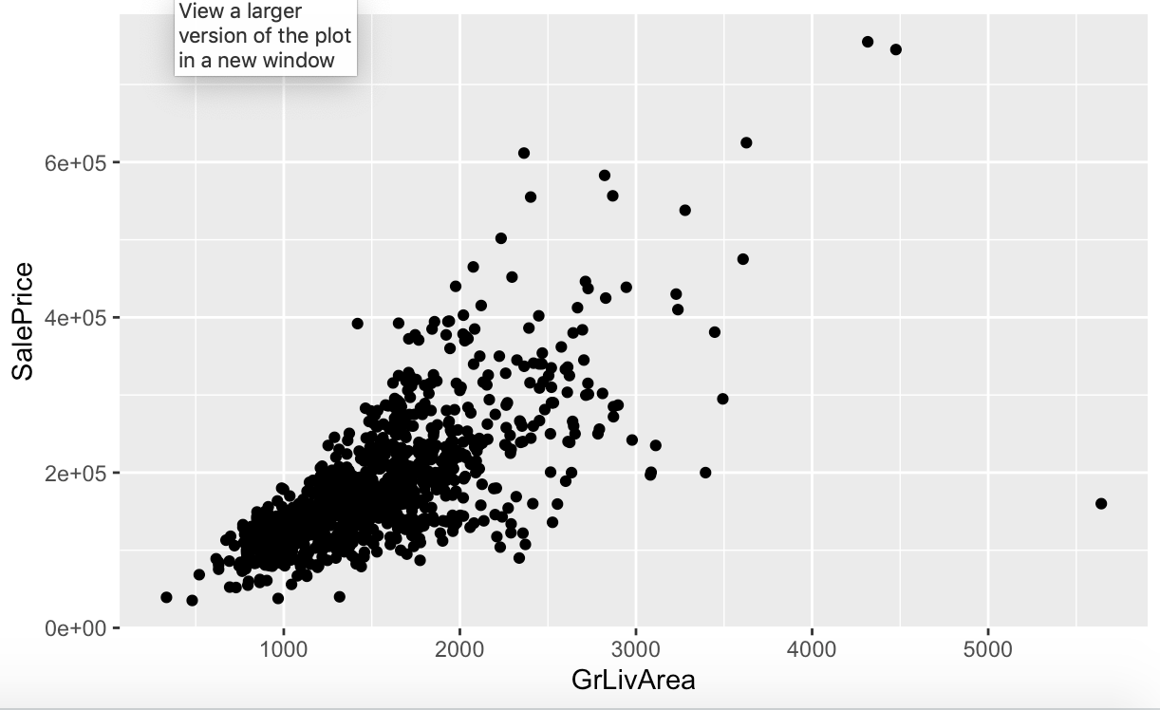
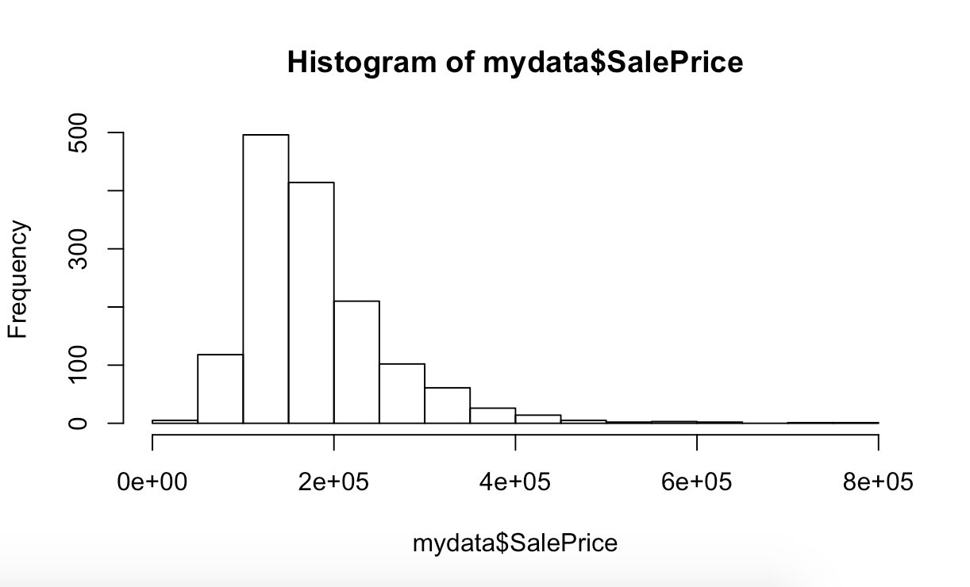
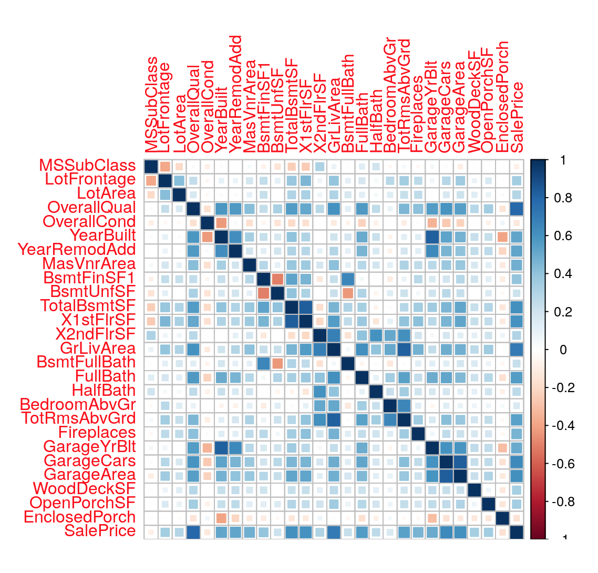
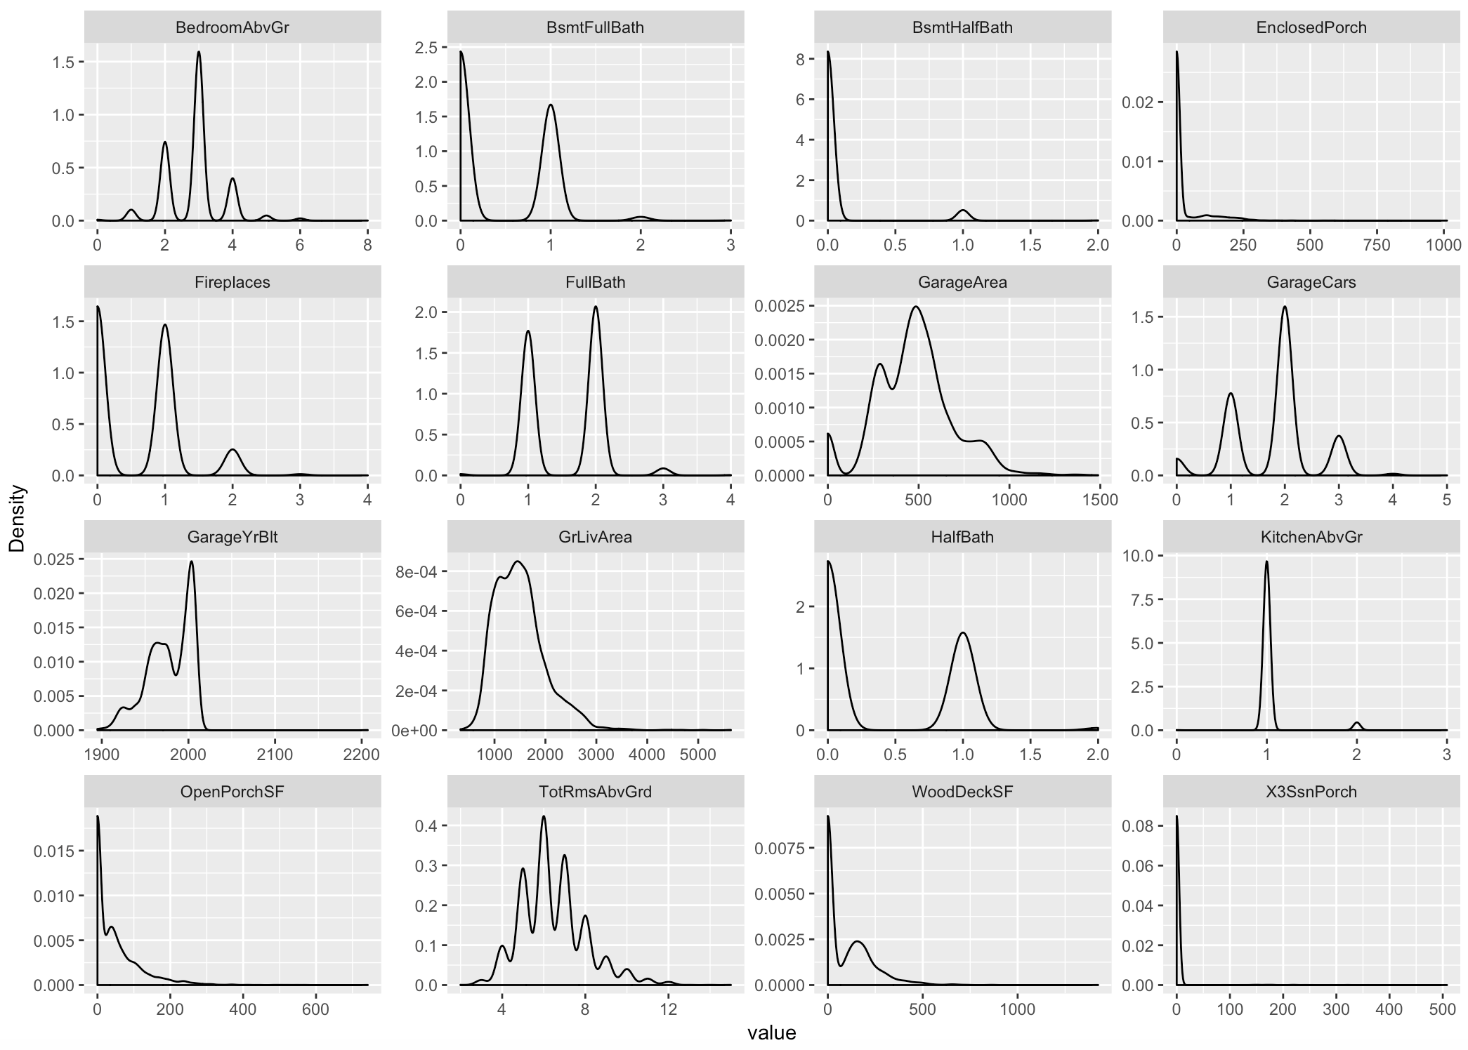
SOME VISUALS

Slide 10
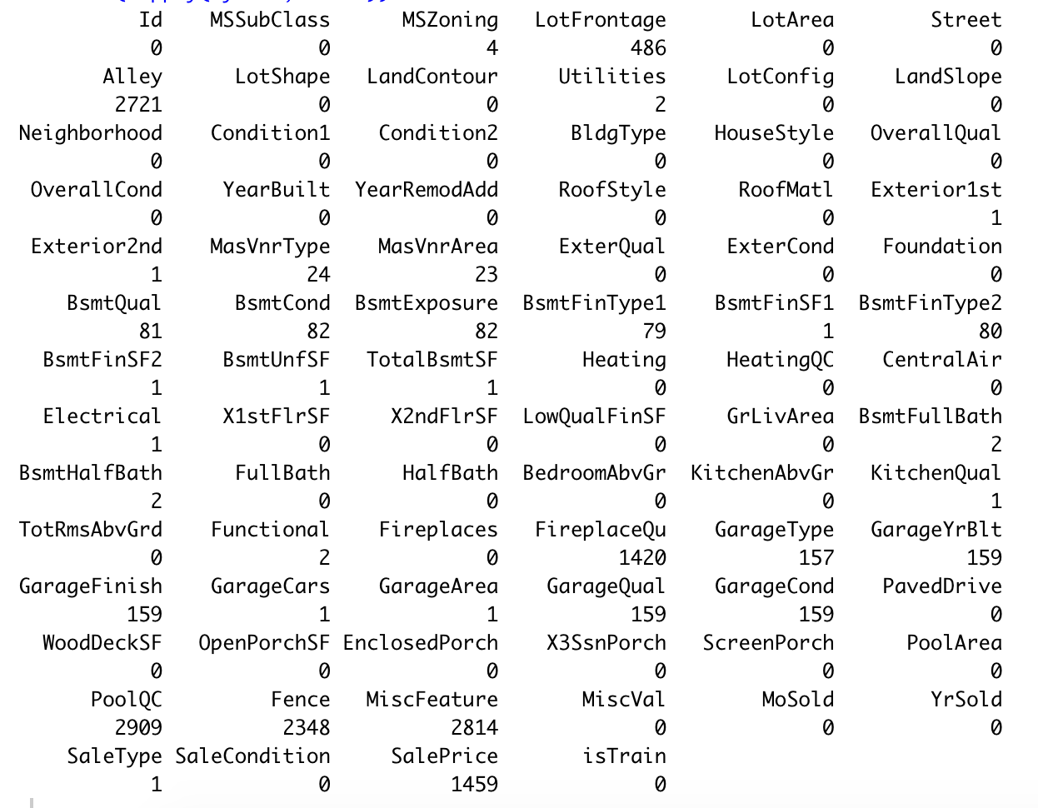
HANDLING MISSING VALUES
The image on the right highlights the missing values present in each variable.
The missing values have been handled by inserting mean, median and zero.
There are a few column variable having values as “NA” which have been replaced by “None” so that they should not be confused NA.
For example, Pool Quality is comprised of 5 classes: Excellent, Good, Fair, Typical, and NA. The NA class describes houses that do not have a pool, but coding language interpret houses of NA class as a missing value instead of a class of the Pool Quality variable.

Slide 11
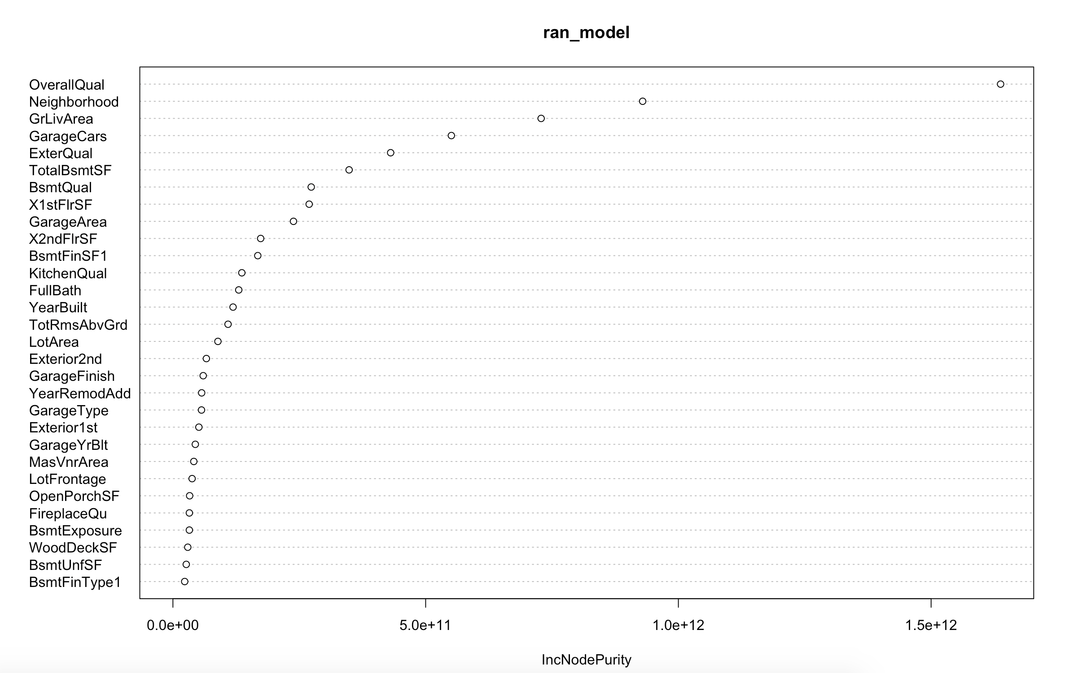
RANDOM FOREST
Predictors related to square footage (Area), quality (different Quality measures), and age (Year Built) have the strongest impact on each model’s predictions.

Slide 12
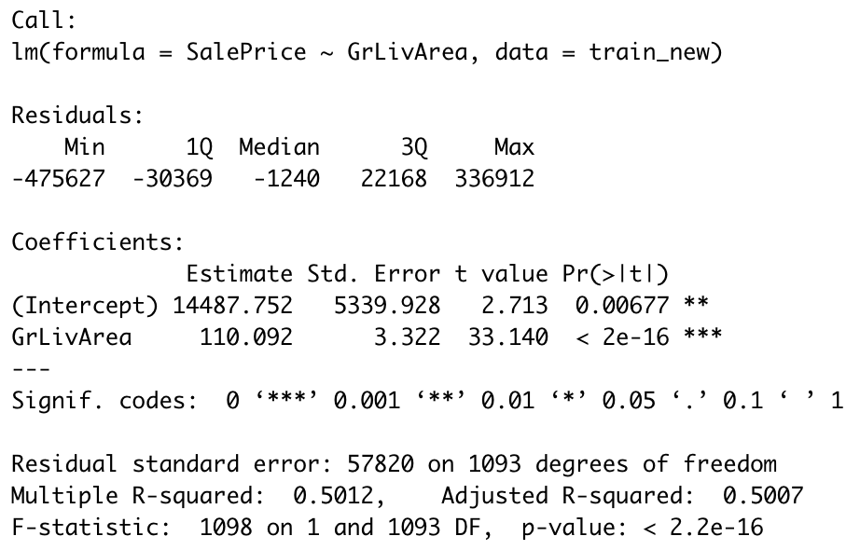
LINEAR REGRESSION

Slide 13
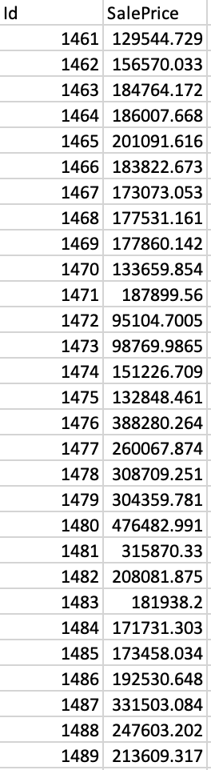
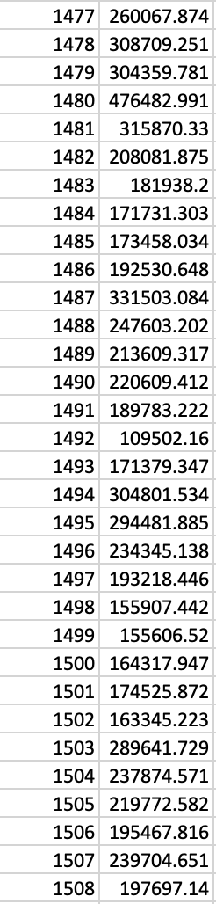
CONCLUSION
There are no best visualizations for these model.
Each of the model’s predictions include the errors.
Tree based model such as random forest cannot provide an idea for each variable in sale price.
Linear model, however, can provide the insight about variables affecting the sale price.
I think Residency in commercial zone is one of the strongest predictor affecting the sale price.

Slide 14
REFERENCES
https://towardsdatascience.com/simple-fast-exploratory-data-analysis-in-r-with-dataexplorer-package-e055348d9619
https://www.kaggle.com/mgmarques/houses-prices-complete-solution/data
Thankyou

